Slide 1
Carbon Emissions Worldwide: Case Study Using Data Analysis and Visualization
By Gopalakrishnan Kumar, MTech IIT-Bombay,
Math AI Trainer, Outlier AI
LinkedIn: Profile Link : https://www.linkedin.com/in/gopalakrishnankumar-a73301110/
Github:https://www.github.com/Gopalakrishnan-Kumar/
Kaggle URL- https://www.kaggle.com/gopalkk2

Slide 2
Google Colab URL
https://colab.research.google.com/drive/1tN7mIx_1kRk9JWbp4UMjqFYHAr5xuzN9?usp=sharing

Slide 3
Introduction
Global climate change is one of the most pressing challenges facing humanity. A major contributor to climate change is the rise in greenhouse gas emissions—particularly carbon dioxide (CO₂)—from human activity. The objective of this case study is to analyze and visualize trends in CO₂ emissions across countries over time, identify the largest emitters, and draw insights that can guide climate-conscious policy and behavior.

Slide 4
Objectives
Visualize emission distributions globally and over time
Identify top carbon emitters and observe their emission trends
Analyze historical CO₂ emissions by country from 2010 to 2023
Support policy insights through data-driven storytelling

Slide 5
Dataset Overview
The dataset used includes year-wise carbon dioxide emissions for
ten major countries:
Column Name | Description
Country | Name of the country
Year | Year of recorded emissions (2010–2023)
CO2_Emissions_MT | CO₂ emissions in million tonnes (MT)

Slide 6
Methodology
Tools and Libraries
Python: Data manipulation and visualization
Pandas: Dataset wrangling
Seaborn & Matplotlib: Trend and comparison plots
Plotly: Interactive choropleth maps

Slide 7
Methodology
Steps Followed
Loaded and cleaned the dataset
Grouped data by year and country
Identified total and per-country emissions
Visualized:
Yearly global trends
Top emitters per year
World map of emissions using choropleth

Slide 8
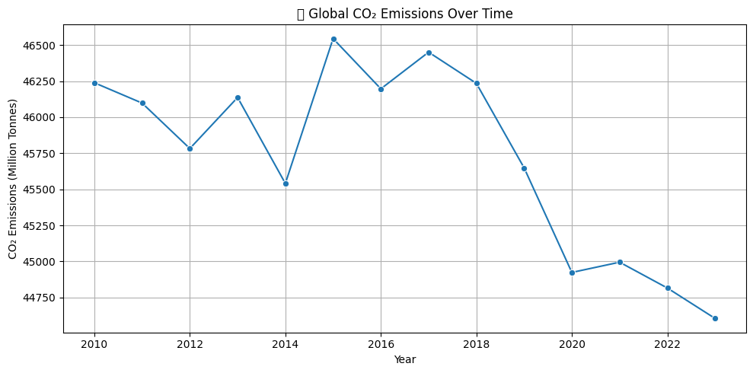
Data Visualization

Slide 9
Key Findings
Global Emissions Trend (2010–2023)
Total global emissions have fluctuated remain on a trajectory.
Minor drops were visible in certain years.

Slide 10
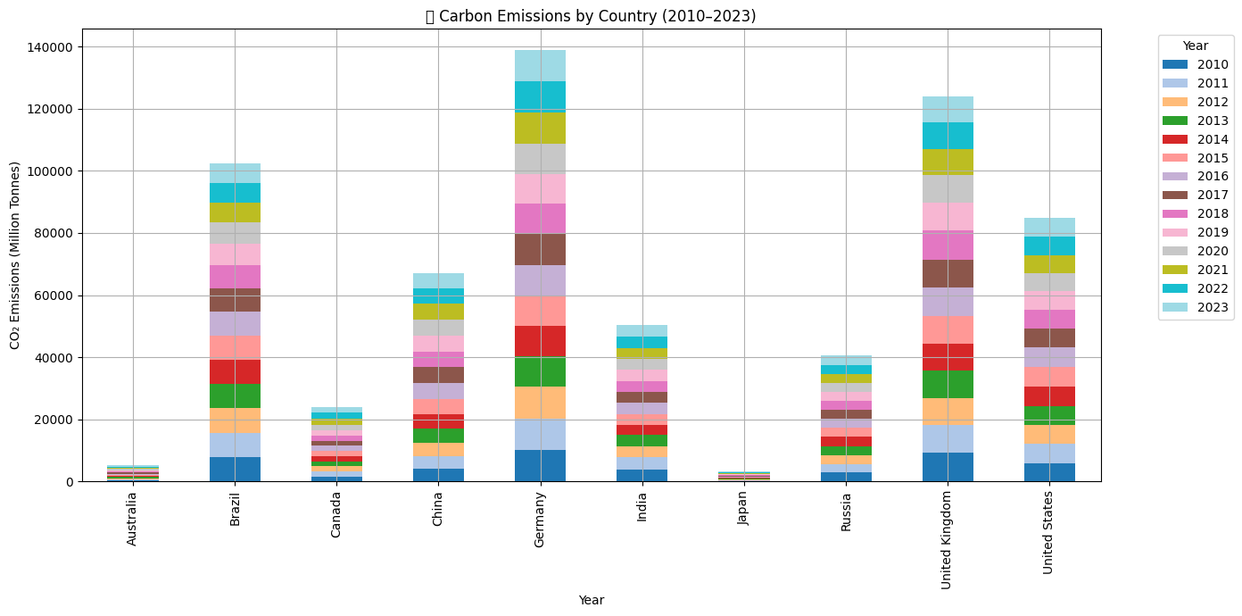
Data Visualization

Slide 11
Key Findings
Top Emitters in 2023
Rank | Country | CO2_Emissions_MT
1 | Germany | 9810
2 | United Kingdom | 8387
3 | Brazil | 6373
4 | United States | 6008
5 | China | 4746
6 | India | 3728
7 | Russia | 3100
8 | Canada | 1830
9 | Australia | 381
10 | Japan | 242

Slide 12
Key Findings
The choropleth map [Refer – Google Colab URL] clearly illustrated emission disparities:
High intensity: Western Europe
Moderate: North America, South America
Low: Asia, Australia

Slide 13
Insights and Interpretation
Developed nations historically contribute more to cumulative emissions, but developing countries are rapidly catching up.
The reduction seen in some regions could be linked to:
Transition to renewable energy
Policy changes like carbon taxation
Corporate sustainability efforts
Year 2020 showed reduced emissions for many countries—likely due to global lockdowns, highlighting the impact of behavioral shifts.

Slide 14
Recommendations
Promote renewable energy investments in top-emitting countries.
Enforce carbon offset programs for industries and governments.
Encourage international cooperation on emissions capping.
Introduce education campaigns focusing on individual carbon footprints.

Slide 15
Tools Used
Pandas for data preprocessing
Seaborn & Matplotlib for line and bar charts
Plotly Express for interactive maps
Jupyter Notebook or Google Colab for workflow

Slide 16
Conclusion
This case study provides a comprehensive view of carbon emissions over the past decade, emphasizing the need for urgent climate action. By leveraging data science tools, we can extract patterns, identify priorities, and support decision-makers in implementing environmentally responsible strategies.

